Slide 1
Fuzzy logic and Fuzzy system
Dr. Bhakti Palkar

Slide 2
Syllabus
Fuzzy logic and Fuzzy system 12 CO4
5.1 Introduction to Fuzzy logic, Fuzzy sets and membership functions, Operations on Fuzzy sets, Fuzzy relations, rules, propositions, implications and inferences, Defuzzification techniques,
5.2 Fuzzy logic controller design, Neuro Fuzzy system, Some applications of Fuzzy logic.
#Self-Learning: Application of Fuzzy system in various appliances.

Slide 3
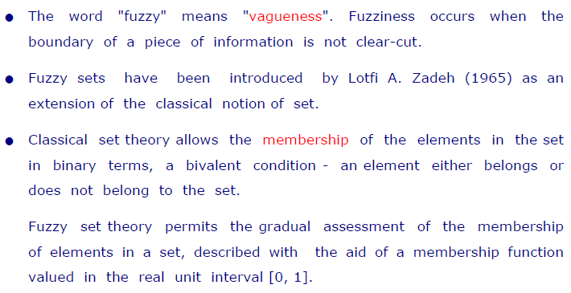
What is fuzzy?

Slide 4
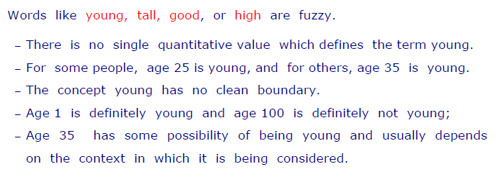
Example

Slide 5
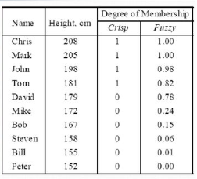
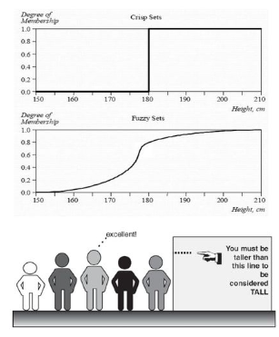
Crisp set and Fuzzy set-Tall men

Slide 6
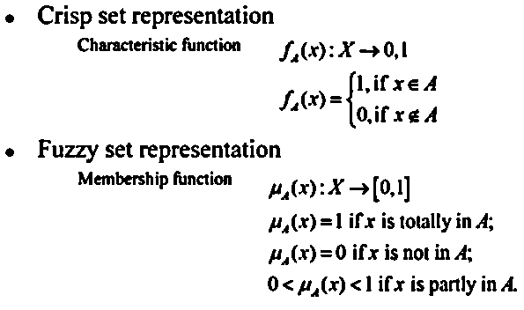
Crisp set and Fuzzy set

Slide 7
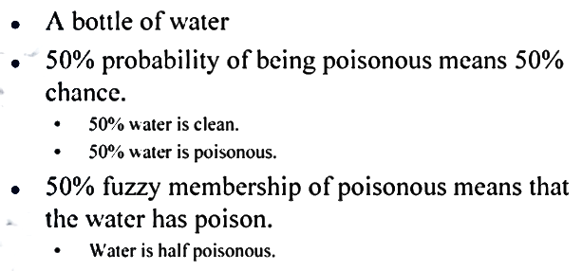
Fuzzy vs Probability

Slide 8
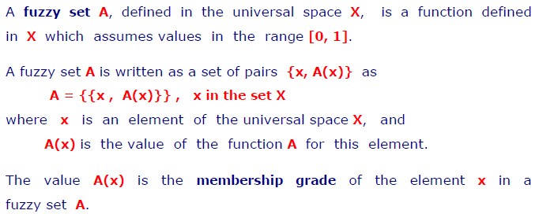
Definition of fuzzy set

Slide 9
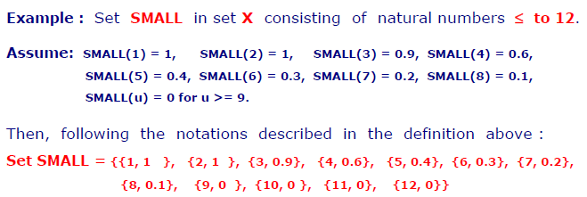
Definition of fuzzy set

Slide 10


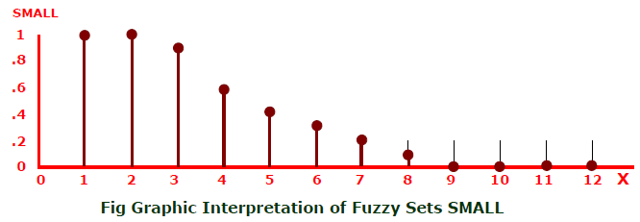
Graphical representation of fuzzy set -small

Slide 11
Operations on fuzzy set-Union
In the case of the union of crisp sets, we simply have to select repeated elements only once. In the case of fuzzy sets, when there are common elements in both fuzzy sets, we should select the element with the maximum membership value.
The union of two fuzzy sets A and B is a fuzzy set C, written as C = A ∪ B
C = A ∪ B = {(x, μ_{A ∪ B} (x)) | ∀x ∈ X}
μ_{A ∪ B} (x)=μ_{C}(x) = max( μ_{A}(x), μ_{B}(x) ), ∀x ∈ X

Slide 12
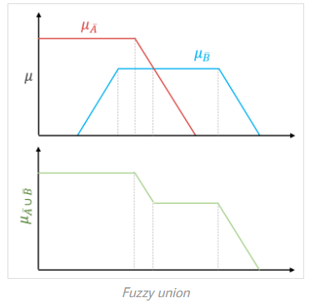
Example of Fuzzy Union:
C = A ∪ B = {(x, μ_{A ∪ B} (x)) | ∀x ∈ X}
A = { (x₁, 0.2), (x₂, 0.5), (x₃, 0.6), (x₄, 0.8), (x₅, 1.0) }
B = { (x₁, 0.8), (x₂, 0.6), (x₃, 0.4), (x₄, 0.2), (x₅, 0.1) }
μ_{A ∪ B} (x₁) = max( μ_{A}(x₁), μ_{B}(x₁) ) = max⁡ { 0.2, 0.8 } = 0.8
μ_{A ∪ B} (x₂) = max( μ_{A}(x₂), μ_{B}(x₂) ) = max⁡ { 0.5, 0.6 } = 0.6
μ_{A ∪ B} (x₃) = max( μ_{A}(x₃), μ_{B}(x₃) ) = max⁡ { 0.6, 0.4 } = 0.6
μ_{A ∪ B} (x₄) = max( μ_{A}(x₄), μ_{B}(x₄) ) = max⁡ { 0.8, 0.2 } = 0.8
μ_{A ∪ B} (x₅) = max( μ_{A}(x₅), μ_{B}(x₅) ) = max⁡ { 1.0, 0.1 } = 1.0
So, A ∪ B = { (x₁, 0.8), (x₂, 0.6), (x₃, 0.6), (x₄, 0.8), (x₅, 1.0) }

Slide 13
Operations on fuzzy set-Intersection
In the case of the intersection of crisp sets, we simply have to select common elements from both sets. In the case of fuzzy sets, when there are common elements in both fuzzy sets, we should select the element with minimum membership value.
The intersection of two fuzzy sets A and B is a fuzzy set C, written as C = A ∩ B
C = A ∩ B = {(x, μ_{A ∩ B} (x)) | ∀x ∈ X}
μ_{C}(x) = μ_{A ∩ B} (x) = min( μ_{A}(x), μ_{B}(x) ), ∀x ∈ X

Slide 14
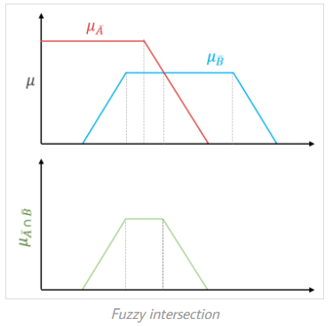
Example of Fuzzy Intersection
C = A ∩ B = {(x, μ_{A ∩ B} (x)) | ∀x ∈ X}
A = { (x₁, 0.2), (x₂, 0.5), (x₃, 0.6), (x₄, 0.8), (x₅, 1.0) }
B = { (x₁, 0.8), (x₂, 0.6), (x₃, 0.4), (x₄, 0.2), (x₅, 0.1) }
μ_{A ∩ B} (x₁) = min( μ_{A}(x₁), μ_{B}(x₁) ) = max⁡ { 0.2, 0.8 } = 0.2
μ_{A ∩ B} (x₂) = min( μ_{A}(x₂), μ_{B}(x₂) ) = max⁡ { 0.5, 0.6 } = 0.5
μ_{A ∩ B} (x₃) = min( μ_{A}(x₃), μ_{B}(x₃) ) = max⁡ { 0.6, 0.4 } = 0.4
μ_{A ∩ B} (x₄) = min( μ_{A}(x₄), μ_{B}(x₄) ) = max⁡ { 0.8, 0.2 } = 0.2
μ_{A ∩ B} (x₅) = min( μ_{A}(x₅), μ_{B}(x₅) ) = max⁡ { 1.0, 0.1 } = 0.1
So, A ∩ B = { (x₁, 0.2), (x₂, 0.5), (x₃, 0.4), (x₄, 0.2), (x₅, 0.1) }

Slide 15
Operations on fuzzy set- Complement
Fuzzy complement is identical to crisp complement operation. The membership value of every element in the fuzzy set is complemented with respect to 1, i.e. it is subtracted from 1.
The complement of fuzzy set A, denoted by A^{C}, is defined as
A^{C} = {(x, μ_{AC} (x)) | ∀x ∈ X}
A^{C} (x) = 1 – μ_{A}(x)

Slide 16
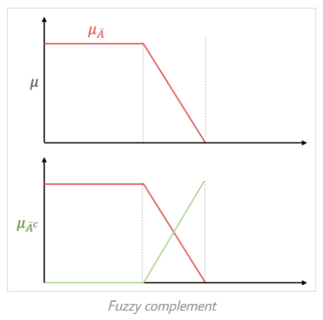
Example of Fuzzy Complement
A^{C} (x) = 1 – μ_{A}(x)
A = { (x₁, 0.2), (x₂, 0.5), (x₃, 0.6), (x₄, 0.8), (x₅, 1.0) }
A^{C} = { (x₁, 0.8), (x₂, 0.5), (x₃, 0.4), (x₄, 0.2), (x₅, 0.0) }
A ⋃ A^{C} = { (x₁, 0.8), (x₂, 0.5), (x₃, 0.6), (x₄, 0.8), (x₅, 1.0) } ≠ X
A ∩ A^{C} = { (x₁, 0.2), (x₂, 0.5), (x₃, 0.4), (x₄, 0.2), (x₅, 0.0) } ≠ Φ

Slide 17
Cartesian product
Let A be a fuzzy set on universe X and B be a fuzzy set on universe Y, then the Cartesian product between fuzzy sets A and B will result in a fuzzy relation R which is contained with the full Cartesian product space or it is a subset of the cartesian product of fuzzy subsets. Formally, we can define fuzzy relation as,
R = A x B
and
R ⊂ (X x Y)
where the relation R has a membership function,
μ_{R}(x, y) = μ_{A x B}(x, y) = min( μ_{A}(x), μ_{B}(y) )

Slide 18
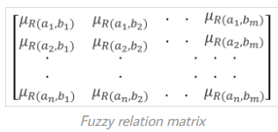
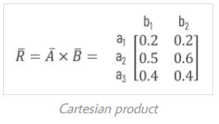
Cartesian product
Let A = {a₁, a₂, …, a_{n}} and B = {b₁, b₂, .., b_{m}}, then the fuzzy relation between A and B is described by the fuzzy relation matrix as,
Example:
Given A = { (a₁, 0.2), (a₂, 0.7), (a₃, 0.4) } and B = { (b₁, 0.5), (b₂, 0.6)}, find the relation over A x B
Cartesian product

Slide 19
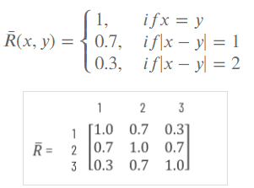
Fuzzy Relation
Fuzzy relations are very important because they can describe interactions between variables.
Example: A simple example of a binary fuzzy relation on X = {1, 2, 3}, called ”approximately equal” can be defined as
R(1, 1) = R(2, 2) = R(3, 3) = 1
R(1, 2) = R(2, 1) = R(2, 3) = R(3, 2) = 0.7
R(1, 3) = R(3, 1) = 0.3
The membership function and
relation matrix of R are given by

Slide 20
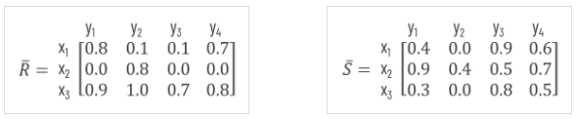
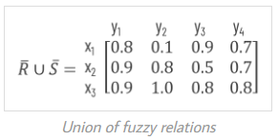
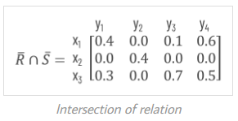
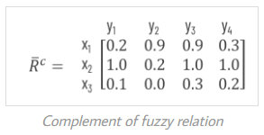
Operations on fuzzy relation:

Slide 21

Fuzzy Proposition
The proposition value for classical proposition is either true or false but in case of fuzzy proposition the range is not confined to only two values it varies from 2 to n.
For example speed may be fast, very fast, medium, slow, and very slow.
In fuzzy logic the truth value of fuzzy proposition also depends on an additional factor known as degree of truth whose value is varies between 0 and 1.
So, we can say that fuzzy proposition is a statement p which acquires a fuzzy truth value T(p) ranges from(0 to1).

Slide 22
Fuzzy Proposition
P : Ram is honest
1
T(P) = 0.0
T(P) = 0.2
T(P) = 0.4
T(P) = 0.6
T(P) = 0.8
T(P) = 1.0
: Absolutely false
: Partially false
: May be false or not false
: May be true or not true
: Partially true
: Absolutely true.
2
3
4
5
6

Slide 23
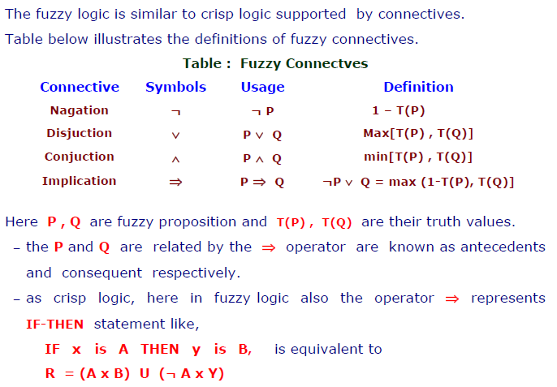
Fuzzy Connectives

Slide 24
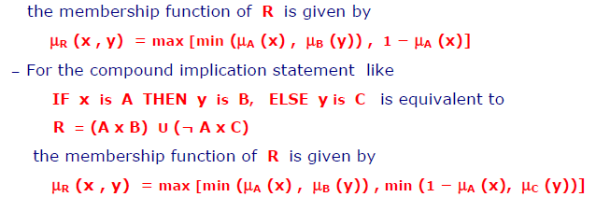
Fuzzy Connectives

Slide 25
Fuzzy Proposition
Example1:
P : Mary is efficient ; T(P) = 0.8;
Q : Ram is efficient ; T(Q) = 0.6
Mary is not efficient.
T (¬P) = 1 − T (P) = 0.2
Mary is efficient and so is Ram.
T (P ∧ Q) = min{T (P), T (Q)} = 0.6
Either Mary or Ram is efficient
T (P ∨ Q) = max T (P), T (Q) = 0.8
If Mary is efficient then so is Ram
T (P =⇒ Q) = max {1 − T (P), T (Q)} = 0.6

Slide 26
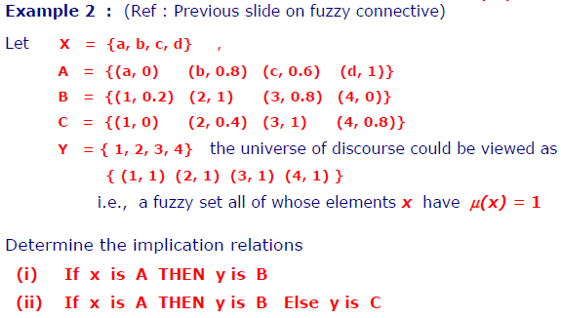
Fuzzy Proposition

Slide 27
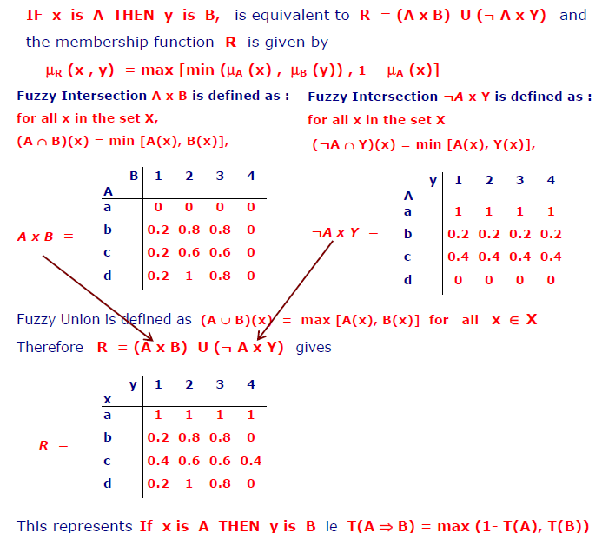
Solution 1:

Slide 28
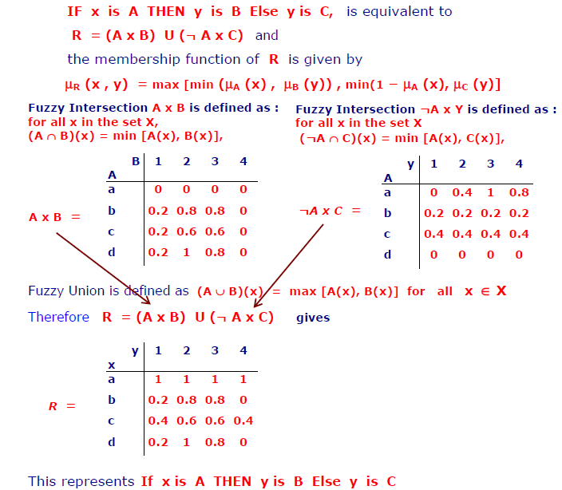
Solution 2:

Slide 29
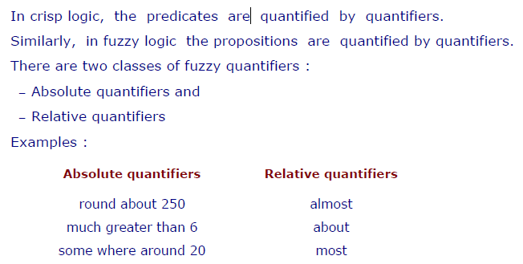
Fuzzy Quantifiers

Slide 30
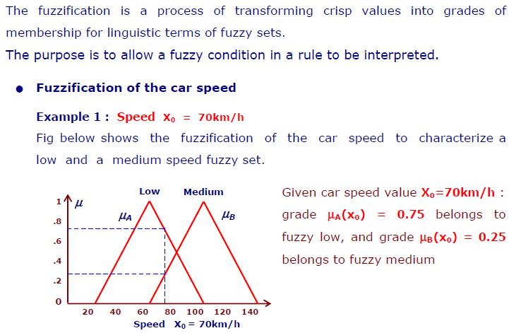
Fuzzification

Slide 31
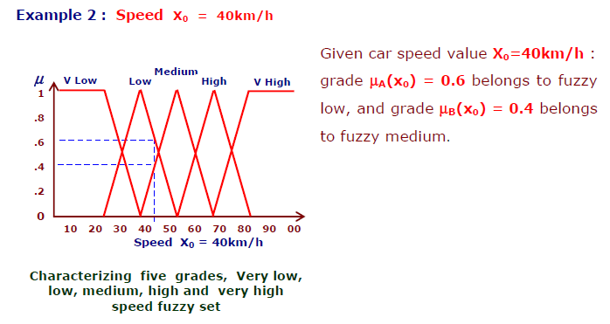
Fuzzification

Slide 32
CONCLUSION
Fuzzy logic provides an alternative way to represent linguistic and subjective attributes of the real world in computing.
It is able to be applied to control systems and other applications in order to improve the efficiency and simplicity of the design process.
Notes:
32

